Slide 1
Huffman Algorithm Implementation- Demo.
Notes:
rithm

Slide 2
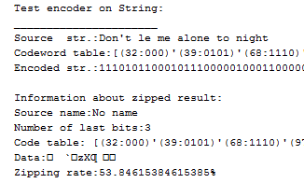
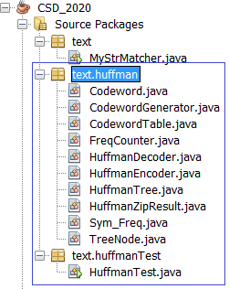
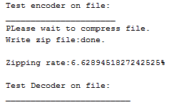


Project structure & Result

Slide 3
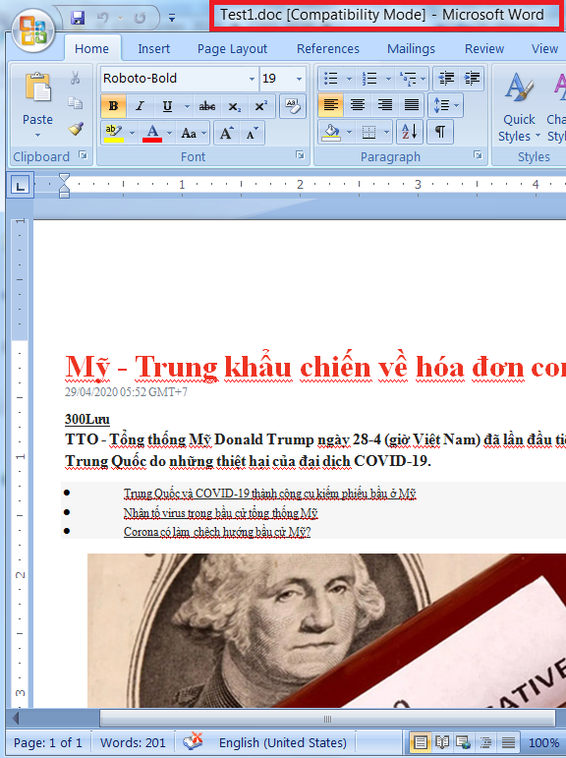
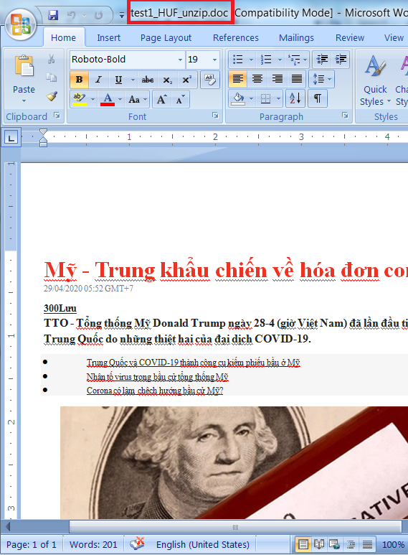
Project structure & Result

Slide 4
Huffman Alg. Mechanism
Data source will be read 2 times → SLOW
Compressing
Source
File
HuffmanEncoder
obj
FreqCounter obj
HuffmanTree
obj
CodewordGenerator
obj
Data source
Freq. table
Huffman Tree
Codeword
Table
Zipped Data
(code table)
HuffmanDecoder
obj
Zipped
File
Decompressing
Codeword table must be written to result → Result size may be rather large
Zipped source is read ONE time → FAST

Slide 5
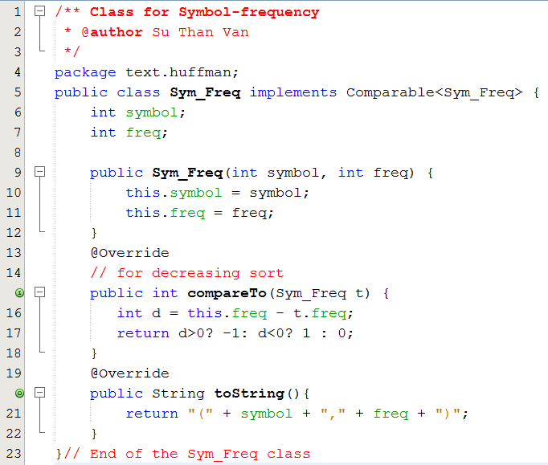
Class Sym_Freq
Connection a symbol with its frequency in data source

Slide 6
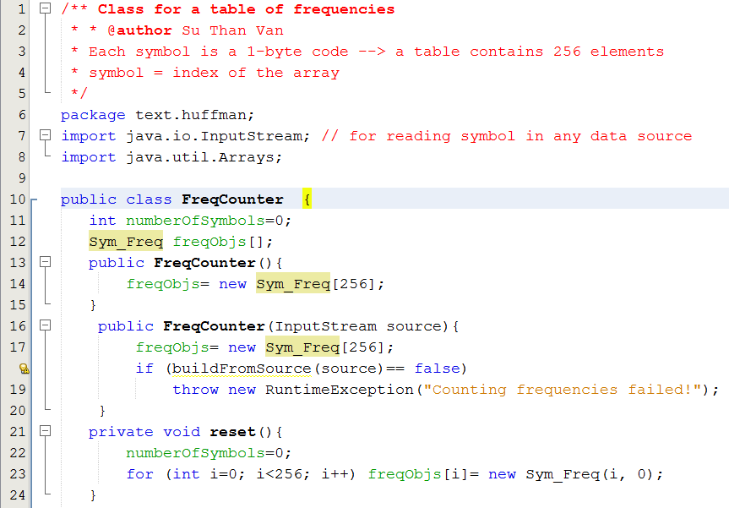
Class FreqCounter

Slide 7
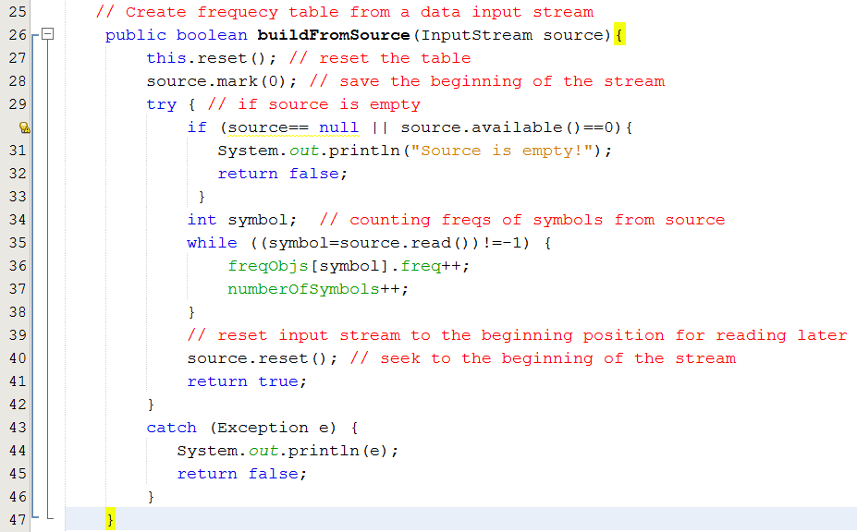
Class FreqCounter

Slide 8
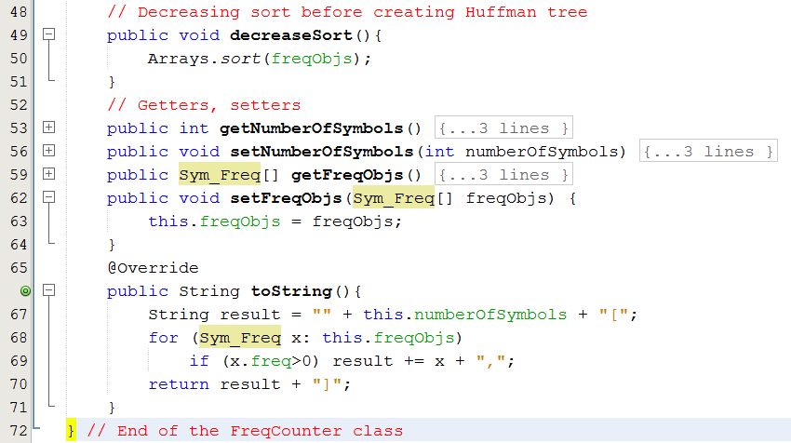
Class FreqCounter

Slide 9
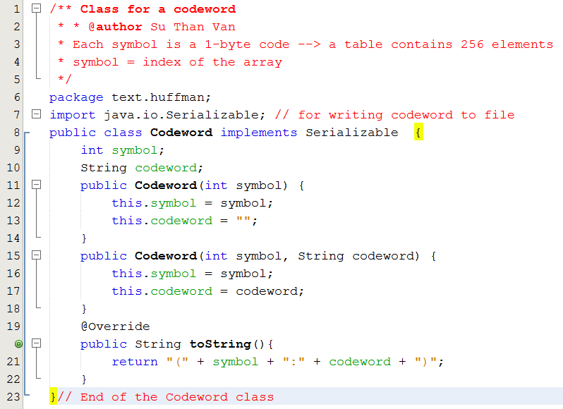
Class Codeword

Slide 10
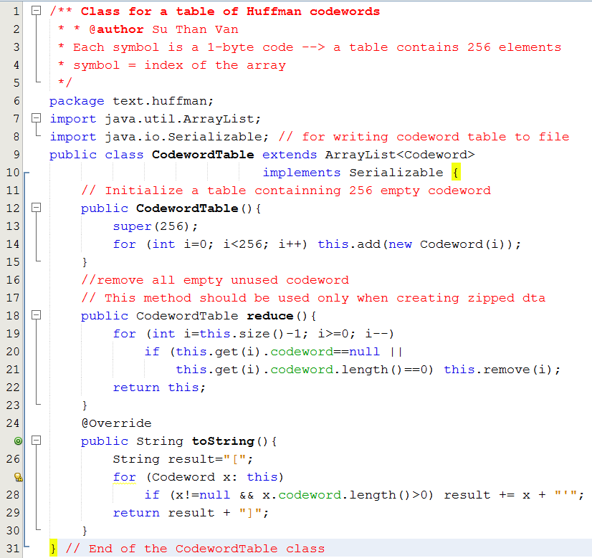
Class CodewordTable

Slide 11
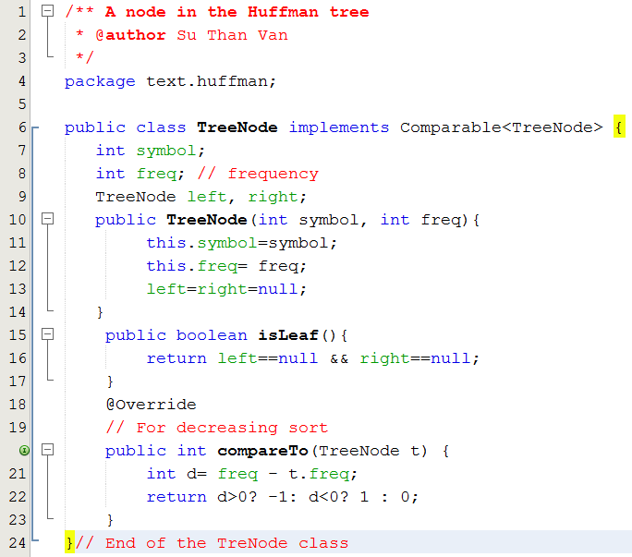
Class TreeNode

Slide 12
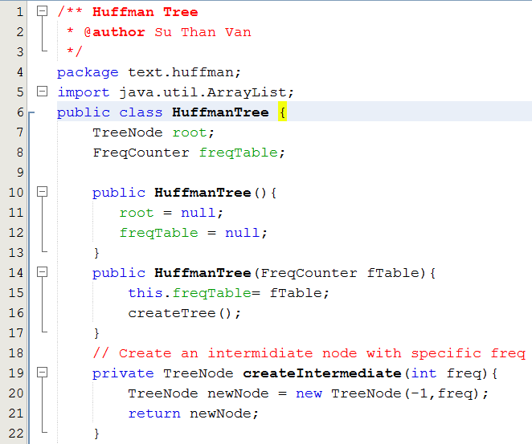
Class HuffmanTree

Slide 13
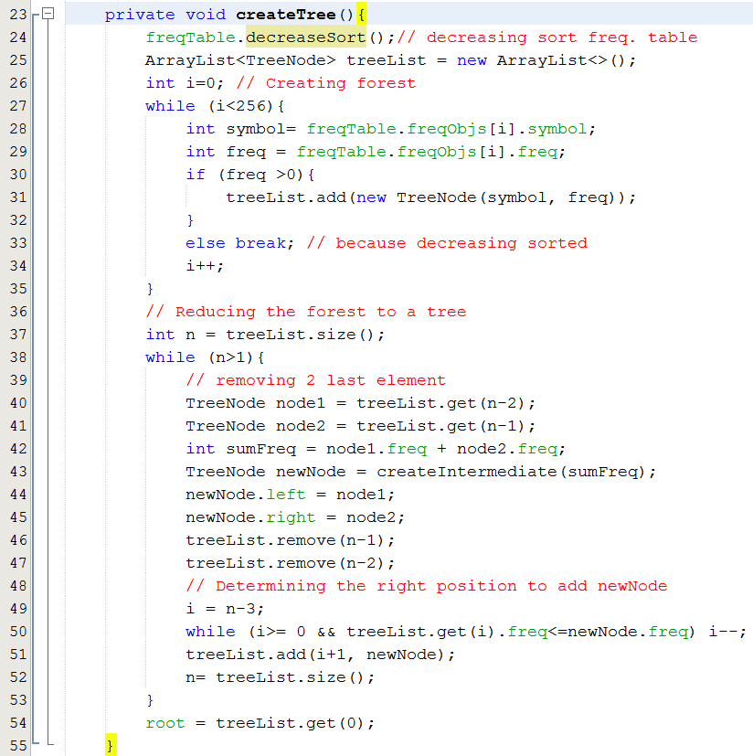
Class HuffmanTree

Slide 14
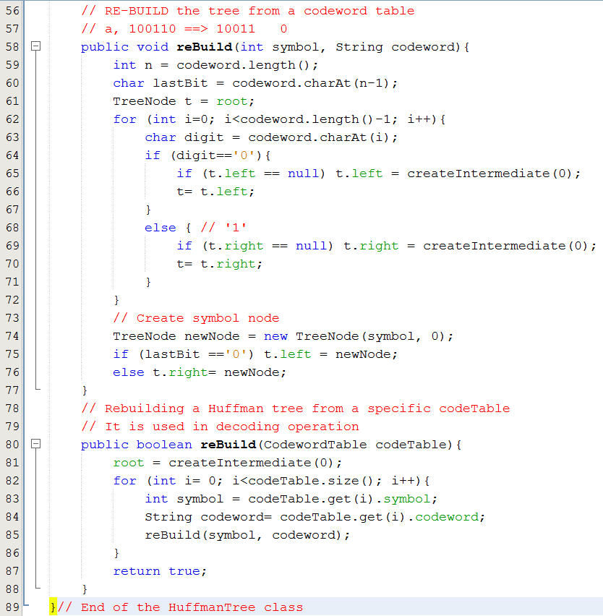
Class HuffmanTree

Slide 15
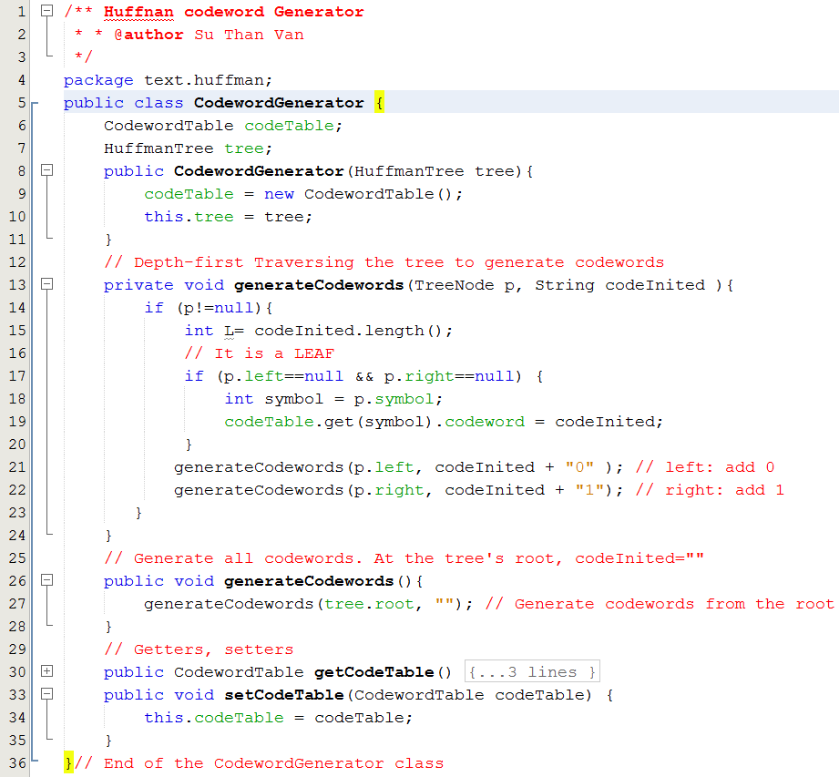
Class CodewordGenerator

Slide 16
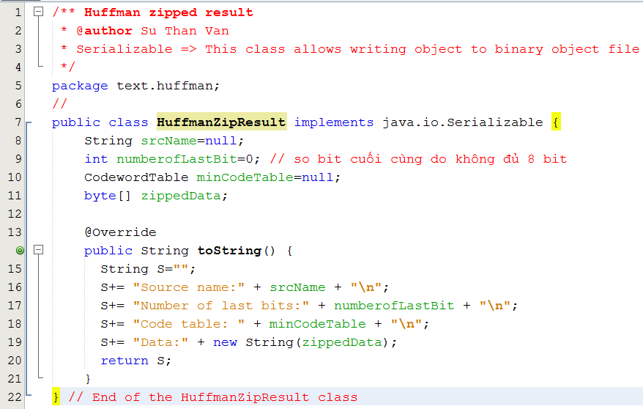
Class HuffmanZipResult

Slide 17
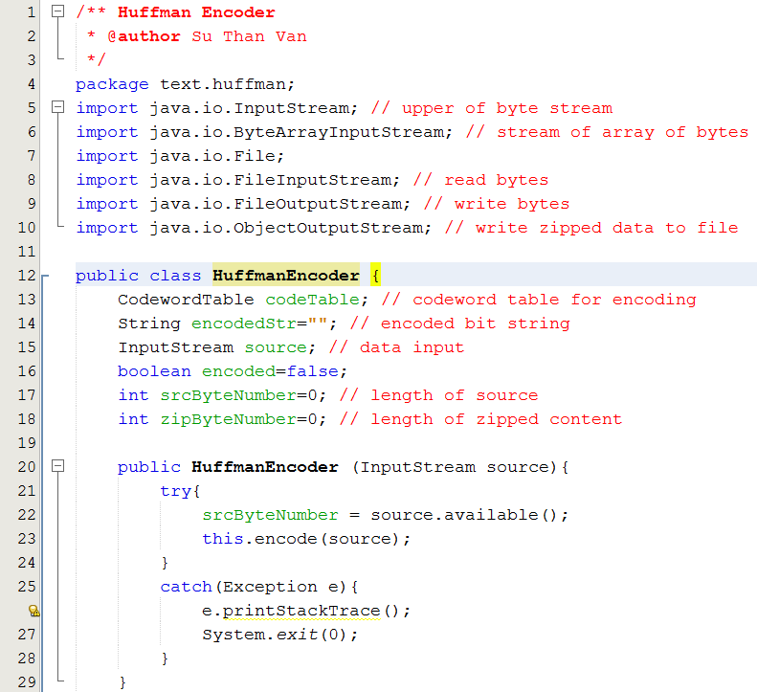
Class HuffmanEncoder

Slide 18
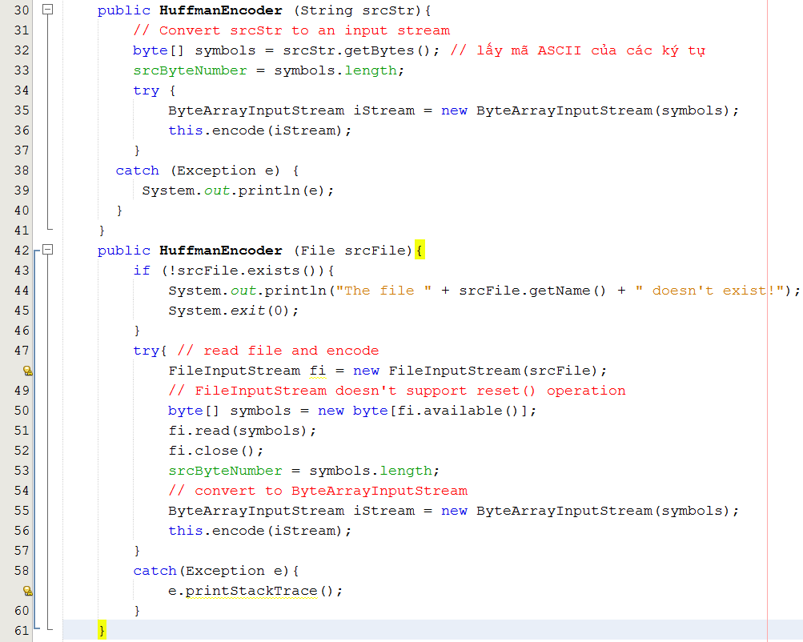
Class HuffmanEncoder

Slide 19
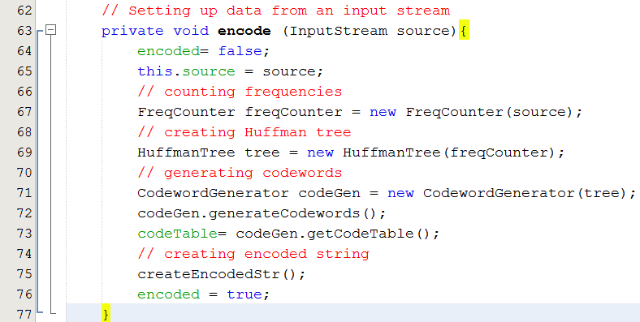
Class HuffmanEncoder

Slide 20
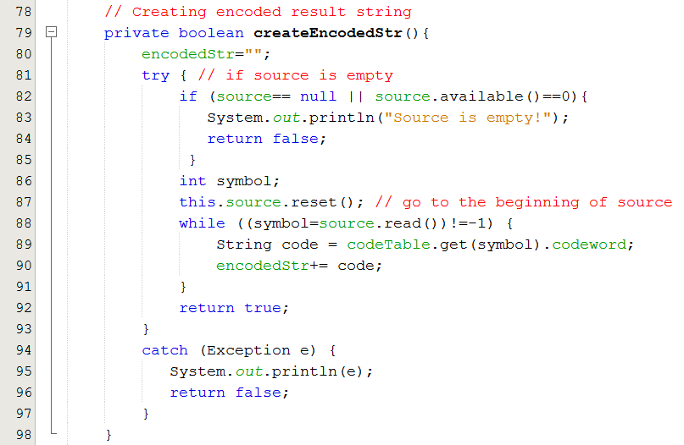
Class HuffmanEncoder

Slide 21
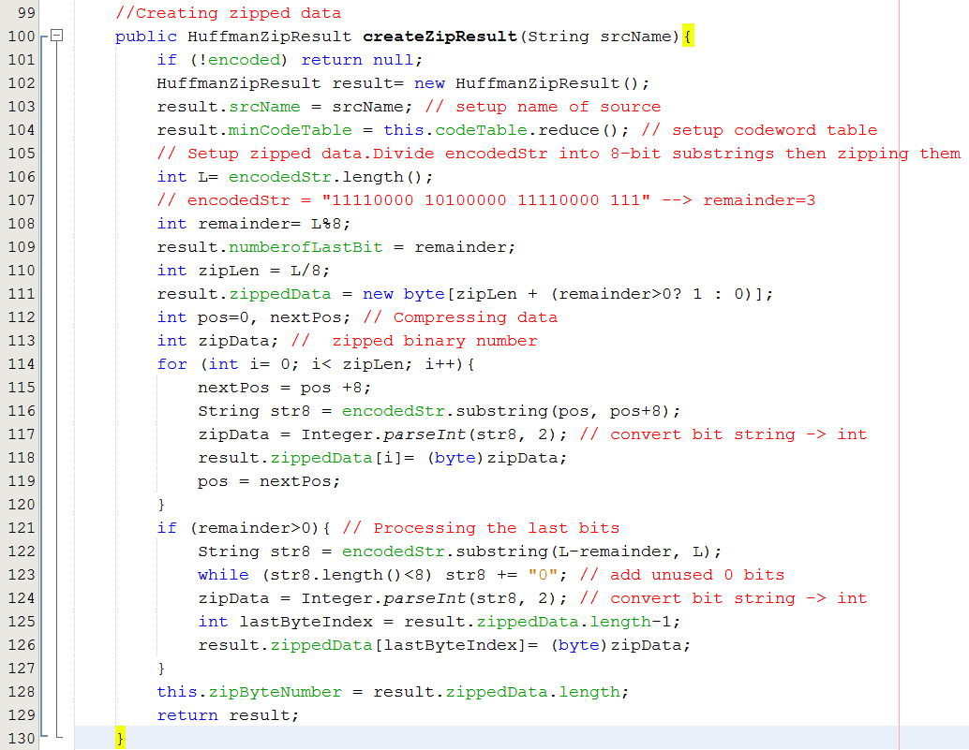
Class HuffmanEncoder

Slide 22
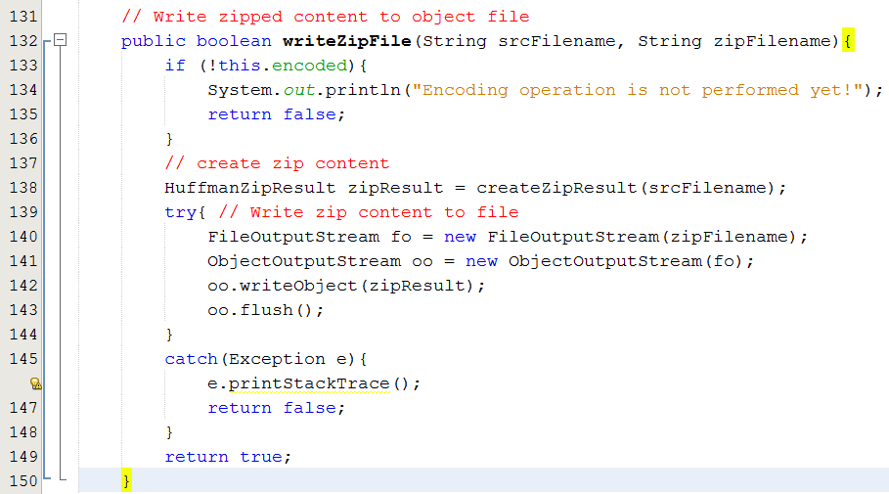
Class HuffmanEncoder

Slide 23
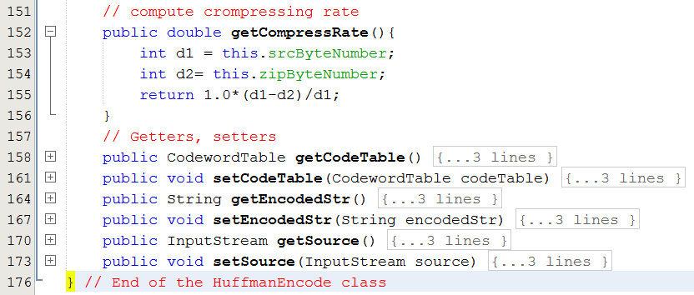
Class HuffmanEncoder

Slide 24
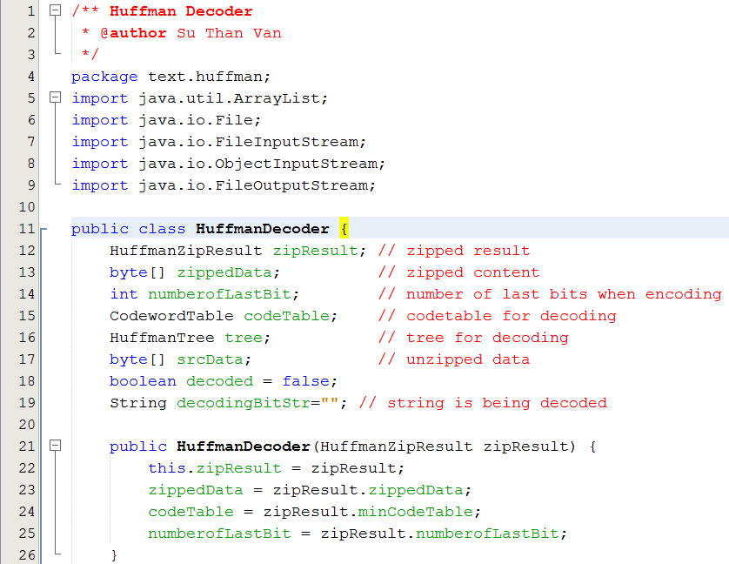
Class HuffmanDecoder

Slide 25
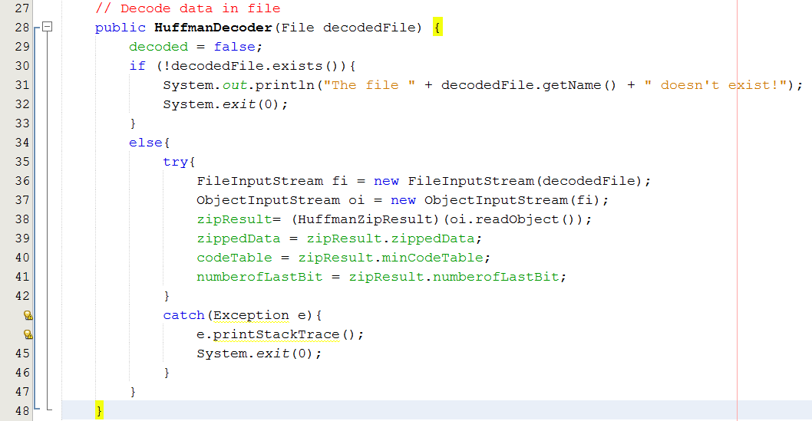
Class HuffmanDecoder

Slide 26
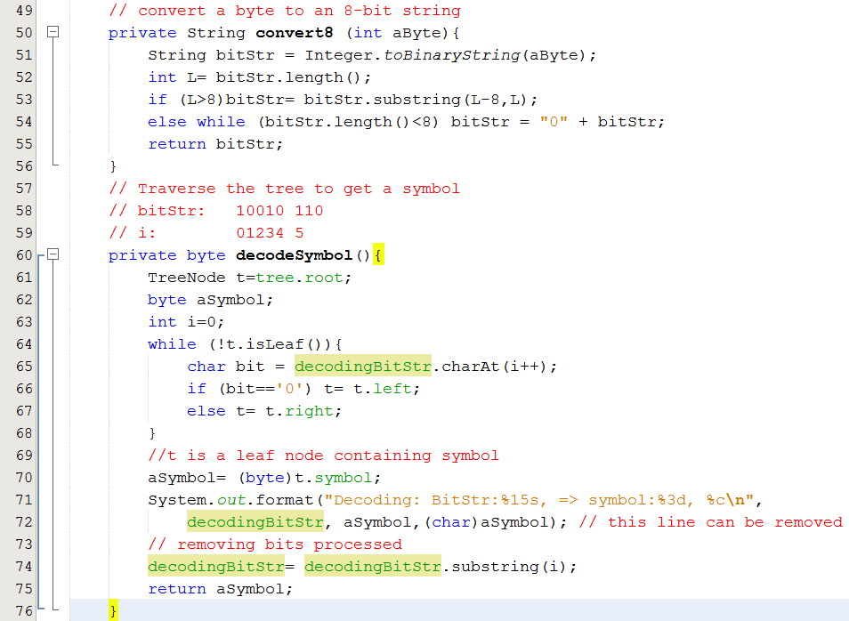
Class HuffmanDecoder

Slide 27
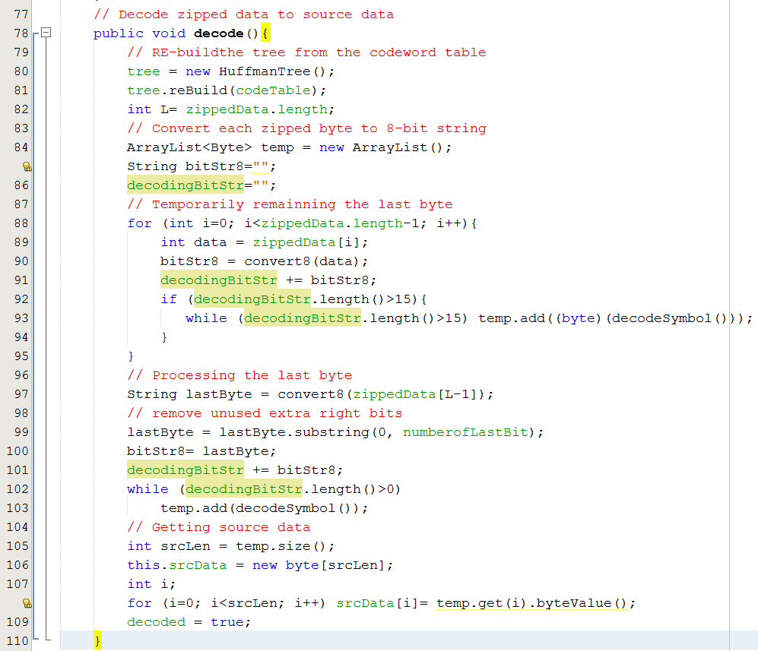
Class HuffmanDecoder

Slide 28
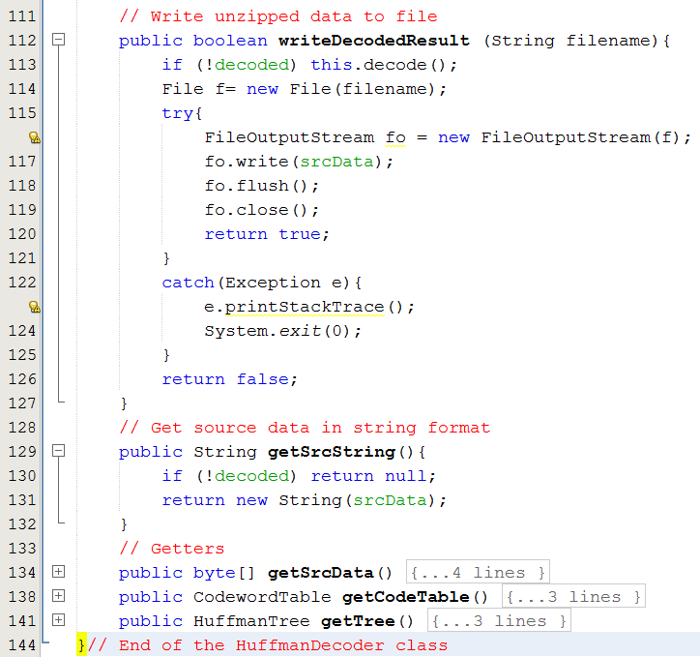
Class HuffmanDecoder

Slide 29
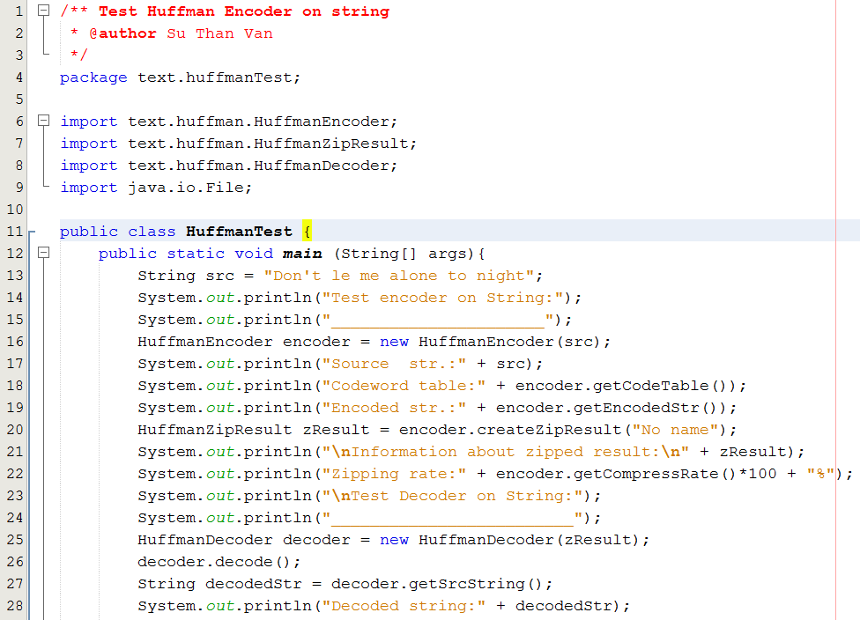
Class HuffmanTest

Slide 30
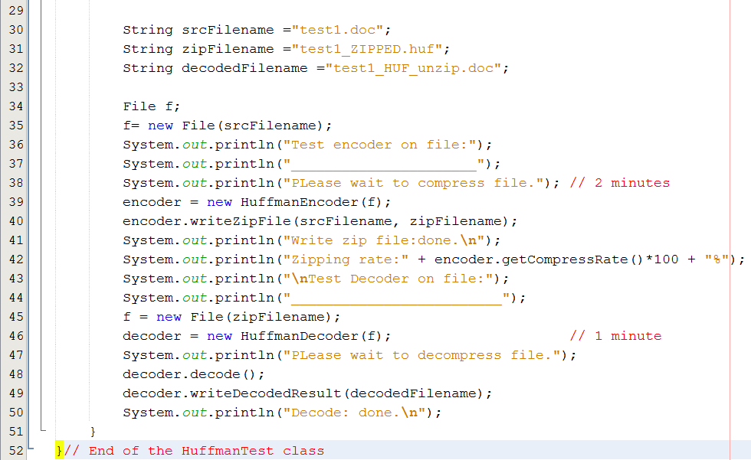
Class HuffmanTest

